Slide 1
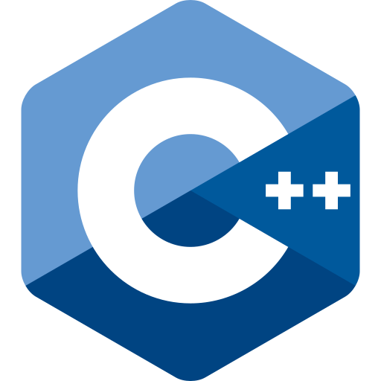

Function
Fundamental Computer Programming C++
Dr. Ihsan Ullah
ihsan@saturn.yzu.edu.tw
Office: 60913

Slide 2
Functions
In C++, a function is a block of code that performs a specific task.
we may put statements into functions to be invoked in the future.
Also known as procedures in some languages.
Why functions?
We need modules instead of a huge main function.
Easier to divide the works: modularization.
Easier to debug : maintenance.
Easier to maintain consistency.
We need something that can be used repeatedly.
Enhance reusability.

Slide 3
Structure of functions
Function is composed of a header and a body.
A header for declaration:
A function name (identifier).
A list of input parameters.
A return value.
A body for definition:
Statements that define the task.
Let’s start with an example.
Input parameters
Function
A returned value

Slide 4
Benefits:
Code reusability
Simplifies code structure
Improves readability and maintainability
Better Organization
Enhances Readability

Slide 5
Function definition
There is an add() function:
In the main function we invoke (call) the
add() function.
Before the main function, there is a function
header/prototype declaring the function.
After the main function, there is a function
body defining the function.
#include <iostream> using namespace std;
int add (int, int); int main ()
{
int c = add(10, 20); cout << c << endl; return 0;
}
int add (int num1, int num2)
{
return num1 + num2;
}
Output 30

Slide 6
Function declaration
To implement a function, we first declare its prototype:
return type function name (parameter types);
In a function prototype, we declare its appearance and input/output format.
int add (int, int);
The name of the function follows the same rule for naming variable.
A list of (zero, one, or multiple) parameters:
The parameters passed into the function with their types.
We must declare their types. Declaring their names are optional.
A return type indicates the type of the function return value.

Slide 7
Function declaration
Some examples of function prototype:
A function receives two integers and returns an integer.
The parameter names may provide “hints” to what this function does.
int add (int num1, int num2); int add (int, int);
– A function receives two double and returns one double.
double divide (double, double);
double divide (double num, double den);
For a function declaration, the semicolon is required.
Every type can be the return type.
– It may be “void” if the function returns nothing.

Slide 8
Creating a function
Declare the function before using it.
Typically after the preprocessors and before the main function.
Then we need to define the function by writing the function body.
Typically after the main function, though not required.
In a function prototype, we do not need to specify parameter names.
But in a function definition, we need!
These parameters can be viewed as
variables declared inside the function.
They can be accessed only in the function.
int add (int num1, int num2)
{
return num1 + num2;
}

Slide 9
Function definition
You have written one function: the main function.
Defining other functions can be done in the same way.
return type function name (parameters)
{
statements
}
The first line, the function header, is almost identical to the prototype.
The parameter names must be specified.
Statements are then written for a specific task.
int add (int num1, int num2)
{
return num1 + num2;
}
The keyword return terminates the function execution and returns a value.

Slide 10
Function invocation
When a function is invoked in the main function, the program execution jumps to the function.
After the function execution is complete, the program execution jumps back to the main function, exactly where the function is called.
What if another function is called in a function?
(Start)
Function 1
Function 2
The main program
Function 3
Function 1
(End)

Slide 11
Function invocation
int add (int, int); void test (int); int main ()
{
int c = add(10, 20); cout << c << endl; return 0;
}
10, 20
10
The main program
add
test
int add (int num1, int num2)
{
test (num1); return num1 + num2;
}
void test (int toPrint)
{
cout << toPrint << endl;
}
30
10 // Print test function
30 // Print by add function

Slide 12
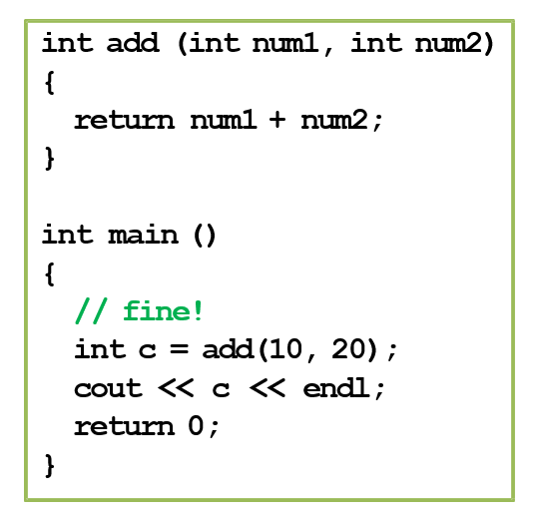
Function declaration and definition
You may choose to define a function before the main function.
– In this case, the function prototype can be omitted.
In any case, you must declare a function before you use it.

Slide 13
Function parameters vs. arguments
When we invoke a function, we need to provide arguments.
Parameters are used inside the function.
Arguments are passed into the function.
If a pair of parameter and argument are both variables, their names can be different.
Let’s visualize the memory events.
int add (int num1, int num2)
{
return num1 + num2;
}
int main ()
{
double q1 = 10.5; double q2 = 20.7;
double c = add(q1, q2); // ! cout << c << endl;
return 0;
}

Slide 14
Function return value
We can return one or no value back to the place we invoke the function.
Use the return statement to return a value.
If you do not want to return anything, declare the function return type as void.
In this case, the return statement can be omitted.
Or we may write return;.
Otherwise, having no return statement results in a compilation error.

Slide 15
Function Reusability
Function reusability refers to writing functions that can be called multiple times throughout a program.
#include <iostream>
using namespace std;
// A reusable function to add two numbers
int add(int a, int b) {
return a + b;
}
// A reusable function to multiply two numbers
int multiply(int a, int b) {
return a * b;
}
int main() {
int num1 = 5, num2 = 10;
int num3 = 6, num4 = 8;
// Calling the reusable functions
cout << "Addition: " << add(num1, num2) << endl;
cout << "Addition2: " << add(num3, num4) << endl;
cout << "Multiplication: " << multiply(num1, num2) << endl;
cout << "Multiplication: " << multiply(num3, num4) << endl;
return 0;
}

Slide 16
Function return value
There can be multiple
return statements.
A function runs until the first
return statement is met.
– Or the end of the function for a function returning void.
We need to ensure that at least one return will be executed!
int test (int);
int main()
{
cout << test(-1); return 0;
}
int test (int a)
{
if (a > 0) return 5;
}

Slide 17
Example
What do these two functions do?
int factorial (int n)
{
int ans = 1;
for (int a = 1; a <= n; a++) ans *= a; // ans = ans * a;
return ans;
}
void factorial (int n)
{
int ans = 1;
for (int a = 1; a <= n; a++) ans *= a; // ans = ans * a;
cout << ans;
}
Which one to choose?

Slide 18
Basics of functions
Scope of variables revisited
More about functions
Variable lifetime
Four levels of variable lifetime (life scope) in C++ can be discussed now.
– local, global, external, and static.
We’ll discuss more types of variables in this semester.

Slide 19
Local variables
A local variable is declared in a block.
It lives from the declaration to the end of block.
In the block, it will hide other variables with same name.
int main()
{
int i = 50; // it will be hidden for(int i = 0; i < 20; i++)
{
cout << i << " "; // print 0 1 2 … 19
}
cout << i << endl; // 50 return 0;
}
Output: 0 1 2 3 4 5 6 7 8 9 10 11 12 13 14 15 16 17 18 19 50

Slide 20
Global variables
A global variable is declared outside any block (thus outside the main function)
From declaration to the end of the program.
It will be hidden by any local variable with the same name.
To access a global variable, use the scope resolution operator ::.
There’s no difference in the way you declare a local or global variable. The locations matter.
We may add auto to declare a local or global variable, but since it is the default setting, almost no one adds this.
#include <iostream> using namespace std;
int i = 5;
int main()
{
for(; i < 20; i++)
cout << i << " "; // ? cout << endl;
int i = 2;
cout << i << endl; // ? cout << ::i << endl; // ? return 0;
}
5 6 7 8 9 10 11 12 13 14 15 16 17 18 19
2
20

Slide 21
External variables
In a large-scale system, many programs run together.
If a program wants to access a variable defined in another program, it can declare the variable with the key word extern.
extern int a;
a must has been defined in another program.
These programs must run together.
It hurts modularization and makes the system hard to maintain.
Though it still exists in some old systems (e.g., some BBS sites).
Note that global variables should be avoided for the same reason.

Slide 22
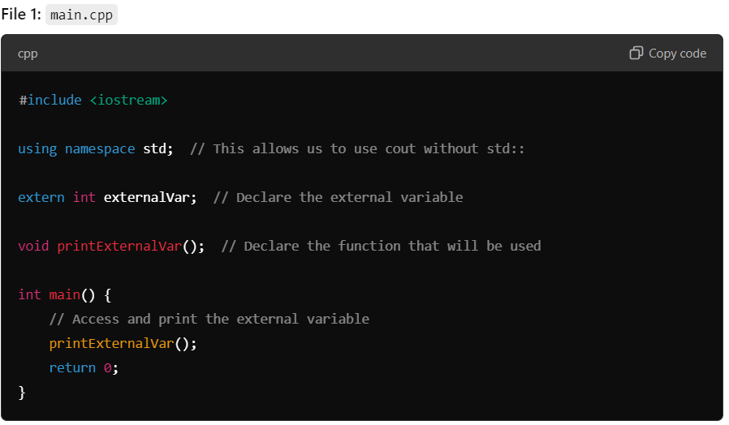
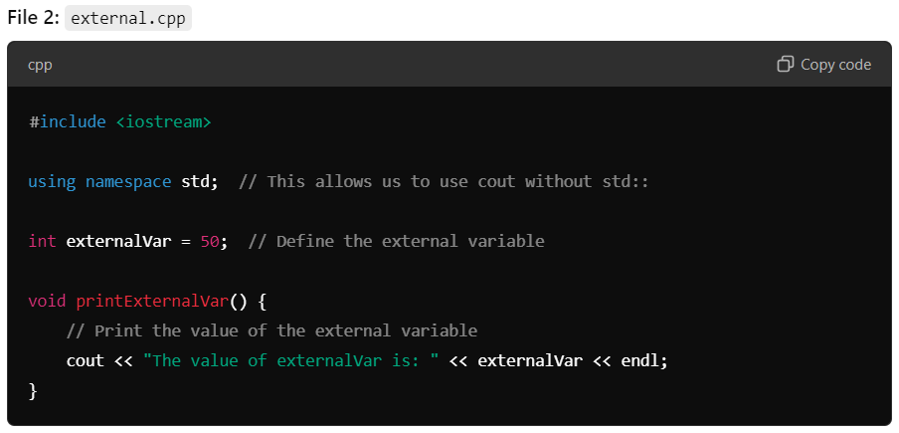
External variables
externalVar is declared as an external variable using extern in main.cpp.
externalVar is defined and initialized in external.cpp, which allows it to be accessed across files.

Slide 23
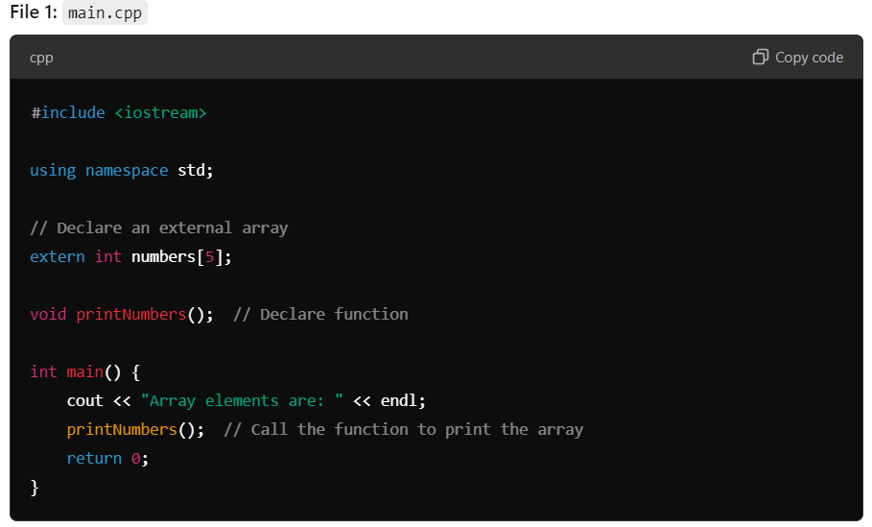
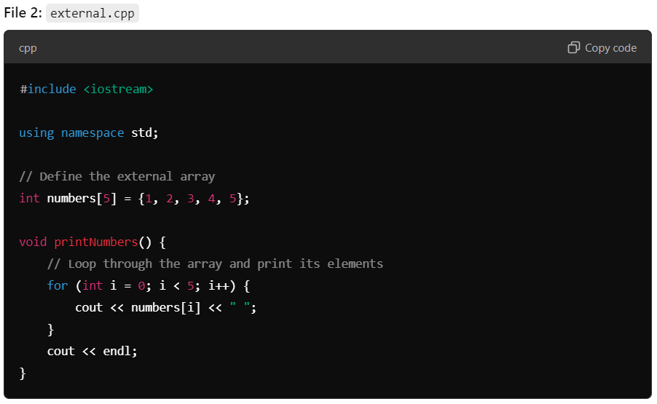
External Array

Slide 24
Static variables
The memory space allocated to a static variable will not be released until the program terminates.
Once a static variable is declared, all other declaration statements will not be executed.
A static global variable cannot be declared as external in other programs.

Slide 25
Instance vs. static variables
In a class, we can define variables and functions.
They are call member variables and member functions.
However, now there can be four types of class members:
Instance variables (default).
Static variables.
Instance functions (default).
Static functions.
Starting from now, when we say member variables (fields) and member functions, we are talking about instance ones.
Control Statements
25

Slide 26
Instance and static variables
Instance Variables:
Variables unique to each object, holding data specific to that instance.
Static Variables:
Variables shared among all objects of the class, containing data common to all instances.
Control Statements
26

Slide 27
Instance and static variables
Instance variables are unique to each object, while static variables are shared among all objects of a class.
b1.y = 30
b1.y =
30
b2.y = 40
b1.x = 10
b1.x =
10
b1.y = 30
b1.x = 20
b2.x =
20
30
40
b1.y =
b2.y = 40
Control Statements
27

Slide 28
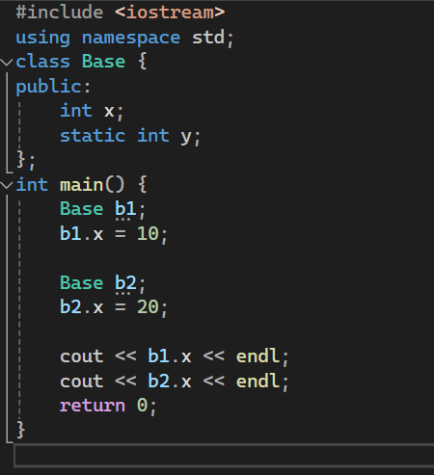
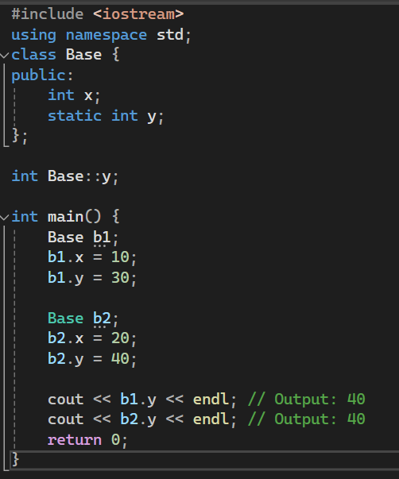
Instance and static variables
Output:
10
20
Output:
40
40
Control Statements
28

Slide 29
Static variables
int test(); int main()
{
for (int a = 0; a < 10; a++) cout << test() << " ";
return 0; // 1, 1, ..., 1
}
int test()
{
int a = 0; a++;
return a;
}
int test(); int main()
{
for (int a = 0; a < 10; a++) cout << test() << " ";
return 0; // 1, 2, ..., 10
}
int test()
{
static int a = 0; a++;
return a;
}

Slide 30
Function overloading
To make programming easier, C++ provides function overloading.
We can define many functions having the same name if their parameters are not the same.
So, we do not need to memorize a lot of function names.
int pow (int, int);
double pow (int, double);
double pow (double, int);
double pow (double, double);
Almost all functions in the C++ standard library are overloaded, so we can use them conveniently.

Slide 31
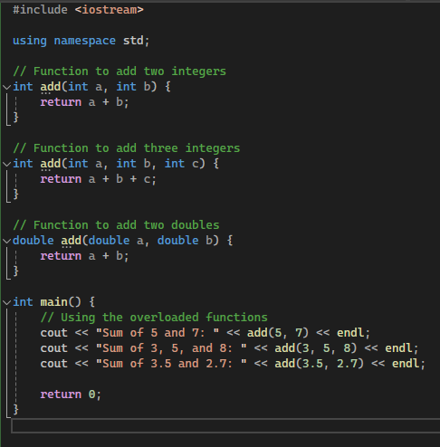
Function overloading

Slide 32
Function overloading
Here are two functions:
void print(char c, int num);
void print(char c);
print() can print c for num times. If no num is assigned, print a single c.
void print (char c, int num)
{
for (int i = 0; i < num; i++) cout << c;
}
void print (char c)
{
cout << c;
}

Slide 33
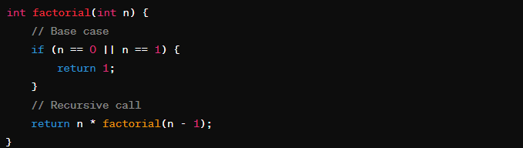
Recursion in C++
Recursion is a programming technique where a function calls itself directly or indirectly.
The base case is a condition that stops the recursion.
The function calls itself with a smaller input until it reaches the base case.

Slide 34
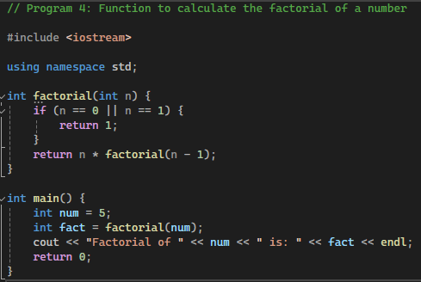
Factorial calculation
Step-by-step execution:
factorial(5) calls factorial(4)
factorial(4) calls factorial(3)
factorial(3) calls factorial(2)
factorial(2) calls factorial(1)

Slide 35
Q. What is Armstrong number?
Ans: 153
= 1*1*1 + 5*5*5 + 3*3*3 = 1 + 125 + 27 = 153

Slide 36
Thanks
Any Question?

